Slide 1

CUSTOMER MARKETING CLUSTRING
Presented By: Biplab Kumar Bhunia, B.Sc. Data Science (3rd Year), Netaji Subhash Engineering Collage

Slide 2
Marketing is crucial for the growth and sustainability of any business.
Marketers can help build the company’s brand, engage customers, grow revenue, and increase sales.
EDUCATION
(Marketers educate and communicate value proposition to customers)
ENGAGEMENT
(Marketers engage customers and understand their needs)
DRIVE SALES
(Marketers drive sales and traffic to products/services)
GROWTH
(Marketers empower business growth by reaching new customers)

Slide 3
SUMMARY
One of the key pain points for marketers is to know their customers and identify their needs.
By understanding the customer, marketers can launch a targeted marketing campaign that is tailored for specific needs.
If data about the customers is available, data science can be applied to perform market segmentation.

Slide 4
In this case study, you have been hired as a consultant to a bank in New York City.
The bank has extensive data on their customers for the past 6 months.
The marketing team at the bank wants to launch a targeted ad marketing campaign by dividing their customers into at least 3 distinctive groups.

Slide 5
# CUSTID: Identification of Credit Card holder
# BALANCE: Balance amount left in customer's account to
make purchases
# BALANCE_FREQUENCY: How frequently the Balance is
updated, score between 0 and 1 (1 = frequently updated, 0 = not frequently updated)
# PURCHASES: Amount of purchases made from account
# ONEOFFPURCHASES: Maximum purchase amount done in one-go
# INSTALLMENTS_PURCHASES: Amount of purchase done in installment
# CASH_ADVANCE: Cash in advance given by the user
# PURCHASES_FREQUENCY: How frequently the Purchases are being made, score between 0 and 1 (1 = frequently purchased, 0 = not frequently purchased)

Slide 6
# PURCHASES_FREQUENCY: How frequently
the Purchases are being made, score between 0 and 1 (1 = frequently purchased, 0 = not frequently purchased)
# ONEOFF_PURCHASES_FREQUENCY: How
frequently Purchases are happening in one-go (1 = frequently purchased, 0 = not frequently purchased)
# PURCHASES_INSTALLMENTS_FREQUENCY: How frequently purchases in installments are being done (1 = frequently done, 0 = not frequently done)
# CASH_ADVANCE_FREQUENCY: How
frequently the cash in advance being paid

Slide 7
# CASH_ADVANCE_TRX: Number of Transactions made with "Cash in Advance"
# PURCHASES_TRX: Number of purchase
transactions made
# CREDIT_LIMIT: Limit of Credit Card for user
# PAYMENTS: Amount of Payment done by user
# MINIMUM_PAYMENTS: Minimum amount of
payments made by user
# PRC_FULL_PAYMENT: Percent of full payment paid by user
# TENURE: Tenure of credit card service for user

Slide 8
K-MEANS INTUITION
K-means is an unsupervised learning algorithm (clustering).
K-means works by grouping some data points together (clustering) in an unsupervised fashion.
The algorithm groups observations with similar attribute values together by measuring the Euclidian distance between points.
AGE
K-MEANS
AGE
SAVINGS
SAVINGS

Slide 9
K-MEANS ALGORITHM STEPS
Choose number of clusters “K”
Select random K points that are going to be the centroids for each cluster
Assign each data point to the nearest centroid, doing so will enable us to create “K” number of clusters
Calculate a new centroid for each cluster
Reassign each data point to the new closest centroid
Go to step 4 and repeat.

Slide 10
AGE
AGE
Place K centroids for each cluster
Assign each data point to the nearest centroid
SAVINGS
SAVINGS
AGE
AGE
Repeat!
Calculate a new centroid for each cluster
SAVINGS
SAVINGS

Slide 11


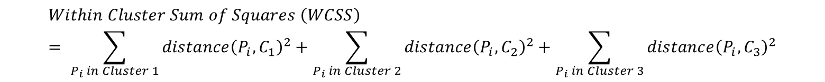




HOW TO SELECT THE OPTIMAL NUMBER OF CLUSTERS (K)? “ELBOW METHOD”
$$Within Cluster Sum of Squares \left(WCSS\right)= \sum_{P_{i} in Cluster 1}{distance{\left(P_{i}, C_{1}\right)}^{2}}+\sum_{P_{i} in Cluster 2}{distance{\left(P_{i}, C_{2}\right)}^{2}+\sum_{P_{i} in Cluster 3}{distance{\left(P_{i}, C_{3}\right)}^{2}}}$$
$$P_{i}$$
AGE
$$C_{3}$$
$$P_{i}$$
$$C_{1}$$
$$P_{i}$$
$$C_{2}$$
SAVINGS

Slide 12


HOW TO SELECT THE OPTIMAL NUMBER OF CLUSTERS (K)? “ELBOW METHOD”
$$Within Cluster Sum of Squares \left(WCSS\right)= \sum_{P_{i} in Cluster 1}{distance{\left(P_{i}, C_{1}\right)}^{2}}$$
NUMBER OF CLUSTERS (K) = 1
AGE
$$P_{i}$$
$$C_{1}$$
SAVINGS

Slide 13


HOW TO SELECT THE OPTIMAL NUMBER OF CLUSTERS (K)? “ELBOW METHOD”
$$Within Cluster Sum of Squares \left(WCSS\right)= \sum_{P_{i} in Cluster 1}{distance{\left(P_{i}, C_{1}\right)}^{2}}+\sum_{P_{i} in Cluster 2}{distance{\left(P_{i}, C_{2}\right)}^{2}}$$
NUMBER OF CLUSTERS (K) = 2
$$P_{i}$$
AGE
$$C_{2}$$
$$P_{i}$$
$$C_{1}$$
SAVINGS

Slide 14
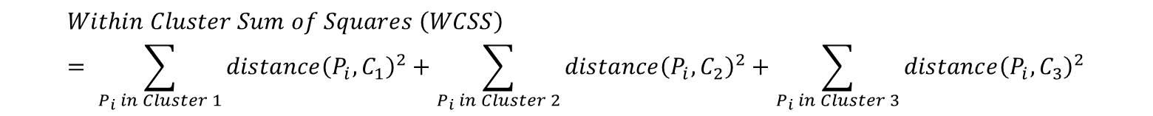
HOW TO SELECT THE OPTIMAL NUMBER OF CLUSTERS (K)? “ELBOW METHOD”
$$Within Cluster Sum of Squares \left(WCSS\right)= \sum_{P_{i} in Cluster 1}{distance{\left(P_{i}, C_{1}\right)}^{2}}+\sum_{P_{i} in Cluster 2}{distance{\left(P_{i}, C_{2}\right)}^{2}+\sum_{P_{i} in Cluster 3}{distance{\left(P_{i}, C_{3}\right)}^{2}}}$$
$$P_{i}$$
AGE
$$C_{3}$$
$$P_{i}$$
$$C_{1}$$
$$P_{i}$$
$$C_{2}$$
SAVINGS

Slide 15
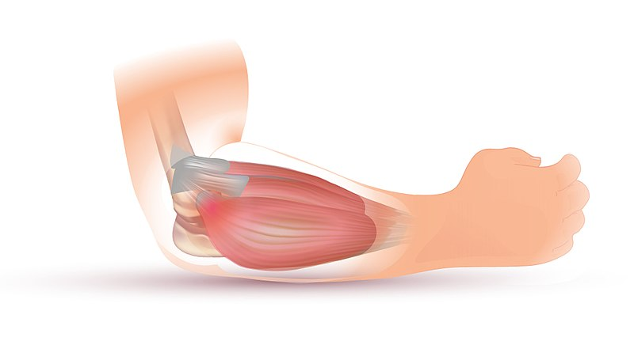
HOW TO SELECT THE OPTIMAL NUMBER OF CLUSTERS (K)? “ELBOW METHOD”
OPTIMAL “K”
(WCSS)
NUMBER OF CLUSTERS “K”
Source: https://commons.wikimedia.org/wiki/File:Tennis_Elbow_Illustration.jpg

Slide 16
THANK YOU !

